Slide 1
FOOD ADULTERATION DETECTION OF TOMATO USING IOT
PAVITHRA E(192FD123)
SHANMUGAVADIVU S (192FD135)
KATHIROLI T G(192FD111)
Under guidance of
Dr.P. PACHAMUTHU PhD
Assistant professor in chemistry.
Integrated AI and Sensor Lab,
BIT, SATHY.

Slide 2
Abstract:
Food adulteration has been a major concern by ambiguous consumers for economic growth and profit.In today’s generation consuming spoilage of food may lead to high risk of public health and decreasing biological value of nutrients in food. It is a food fraud that's mainly in the industry of food.Authentication of food and the detection of adulterants in diverse food items should be taken into account to safeguard consumers from fraudulent operations.In this study,we aim to detect the freshness of fruits(Tomato), by enabling the action of Internet of things(IOT).When a microcontroller detects gas in fruit, it sends the information to the internet of things.To predict how frequently a food will degrade, we employed IoT, and sensors. This will enhance supermarket competition, resulting in the sale of more organic and natural items. This research looks at how the Internet of Things may be used to detect the freshness of food. It reads cloud data from the sensors that are associated with it and microprocessors, as well as electrical and biosensors such as a moisture sensor and an ethanol gas sensor, are all components of the system that will be detected.This study determines that deep learning neural network called a convolutional neural network (CNN) is a form of deep learning neural network. CNNs are a significant advancement in image recognition. They're most usually utilized to examine visual imagery, and they're regularly involved in picture categorization behind the scenes When the results of CNN and sensor valve are compared, it is decided if the food is fresh or corrupt.

Slide 3
Problem Statement Addressed:
1)Growing global population demand for fresh, imported perishables.
2) Resulting in greater demand for higher-quality fresh food.
3) Before being marketed, fruits and vegetables are exposed to large number of elements that contaminate them .
4) Impact their freshness and quality.

Slide 4
Existing Solution to the Problem Addressed:
The key issues is high level of adulterant using in fruits in fssai norms .
.By using IOT technology, we detect freshness of fruits.
It leads to avoid fraudulent from consumers.
It helps consumers for adequate amount of nutrition .
Avoid spoilage for long term.

Slide 5
Proposed Solution to the Problem Addressed:
1)It might be a part of the food supply chain, tracking food conditions and exchanging data with consumers in real time.
2) To improve food quality.
3) The key issues is high level of adulterant using in fruits in fssai norms.By using IOT technology, we detect freshness of fruits.
4)It leads to avoid fraudulent from consumers.
5) It helps consumers for adequate amount of nutrition .
avoid spoilage for long term.

Slide 6
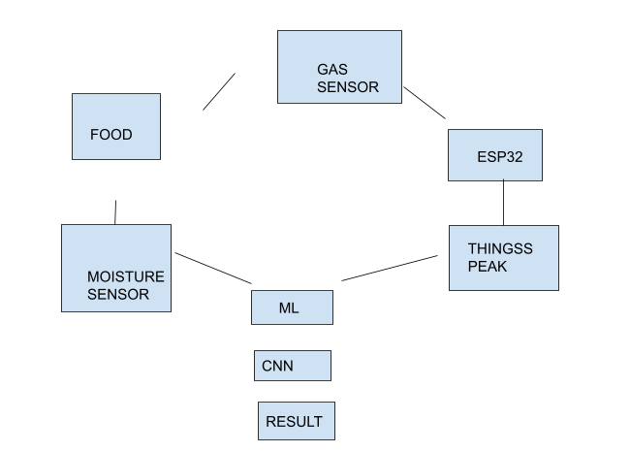
Block Diagram and/or Circuit Diagram:

Slide 7
Effective utilization of the Modern Tool & Cloud:
CNNs can be used for image processing, natural language processing, and a variety of other cognitive tasks.
CNN is a feed-forward neural network (FFNN) with multiple layers that can quickly recognise, identify, and recognise any feature in an image.
It's mostly applied with visual data, like imagery categorization.

Slide 8
. The system consists of a microcontroller, moisture sensor, and ethanol gas sensor. The proposed system detects moisture as well as harmful substances in the area.
The moisture sensor uses a moisture sensor to detect moisture, and the MQ3 gas sensor to measure alcohol gas levels in food. Ethanol-related gas emissions are detected using the MQ3 sensor. Food and fruits emit ethanol-like fumes when they deteriorate. When the fruit is rotten, the moisture sensor detects an increase in the moisture level.
ML can detect food based on external features like as texture, colour, and size, which aids in early food classification.

Slide 9
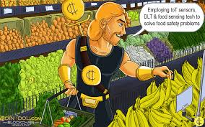
Technology stack & use case:

Slide 10
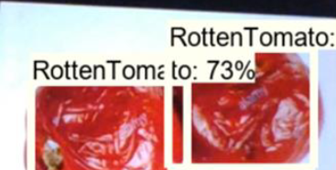
Prototype & Sample Output :

Slide 11
Analysis of Results & Discussions:
We incorporated various real-world examples(tomato) to boost the functionality and applicability of our dataset. The use of sensors to detect these values in foods can help in the early identification of food deterioration and avoid consuming contaminated food.
These technologies might be developed to incorporate various types of gas sensors and meals to increase the sensitivity of such detection systems.
As a result, the suggested method effectively boosts fruit identification rates.

Slide 12
References:
1.Zhou C, Tan S, Li J, Chu X, Cai K (2014) A novel method to
stabilize meat colour: ligand coordinating with hemin. J Food Sci
Technol 51:1213–1217
2. Dixit S, Khanna SK, Das M (2013) All India survey for analyses
of colors in sweets and savories: exposure risk in Indian popula-
tion. J Food Sci 78:642–647
3. Stevens LJ, Burgess JR, Stochelski MA, Kuczek T (2015)
Amounts of artifcial food dyes and added sugars in foods and
sweets commonly consumed by children. Clin Pediatr (Phila)
54(4):309–321

Slide 13
THANK YOU

